Slide 1
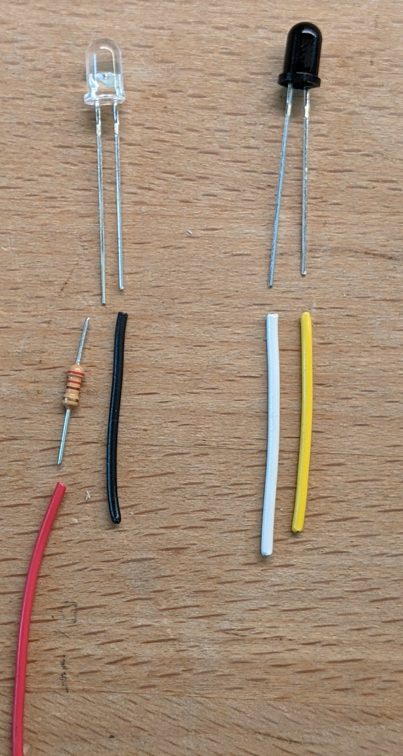
IR Emitter / Detector Wiring
The Clear LED is the Emitter.
Connect a Red wire to a 220 ohm resister and then to the long lead. On the short lead, connect a black wire.
Use 24-26 AWG stranded wire.
When powered with 5 volts,
Each emitter will draw about 14 mA.
The Dark Blub Component is the Detector.
Connect a white wire to the long lead. Connect a yellow wire to the short lead.
Use 24-26 AWG stranded wire.
In the circuit, the white lead will be connected to ground. When the detector is “on”, current will flow from the yellow wire though the detector to ground.

Slide 2
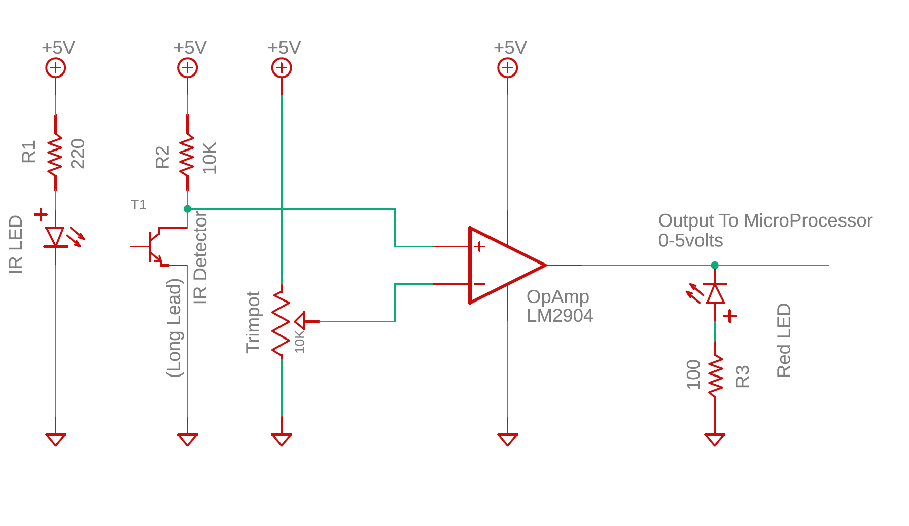
IR Emitter / Detector Test Circuit
Notes:
The IR Emitter, as shown with a 220 ohm resistor draws about 17 mA.
The voltage at the + terminal on the OpAmp runs between 0.12 volts when the beam is detected, and 3.5 volts when the beam is broken.
The OpAmp is wired as a simple comparator. It outputs a hard 0 volts if the beam is detected, and about 3.5 volts if the beam is broken.
The Red LED after the OpAmp is included to indicate when the beam is broken.

Slide 3
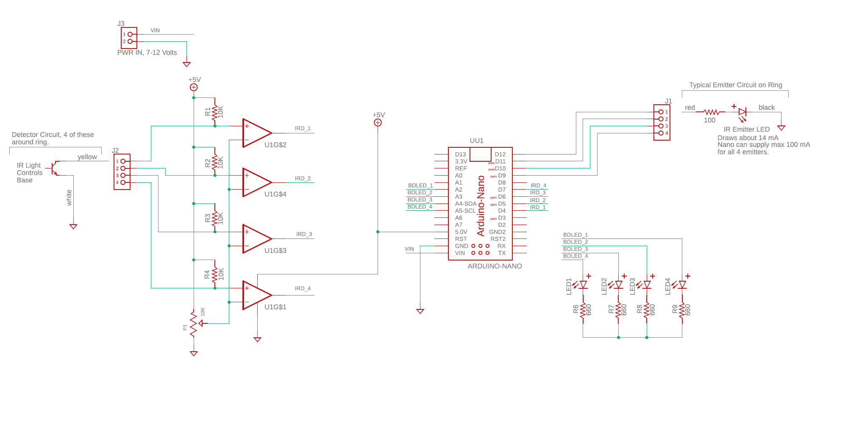
Ring Detection Circuit, Version 1

Slide 4
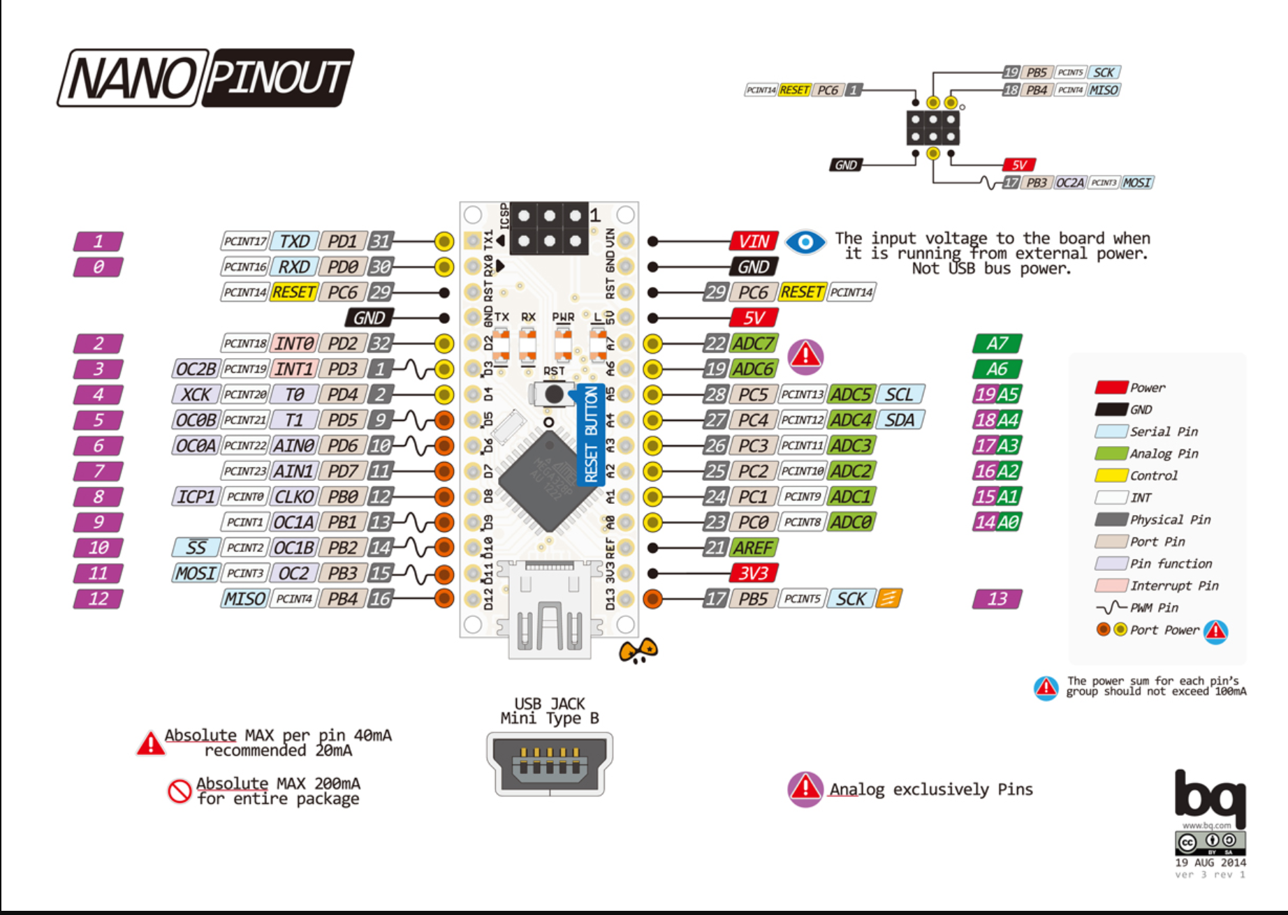
INFO About Arduino NANO – Pin Mappings

